Slide 1
Celaine weaving
2016.

Slide 2
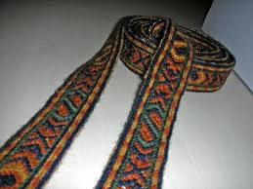
Celaine weaving technique was known in ancient Egypt. Egypt's oldest celaine fabric was woven only from flax fiber and used in making ceremonial costumes.
During the Middle Ages celaine technique was widespread throughout northern Europe, especially in Scandinavia.

Slide 3
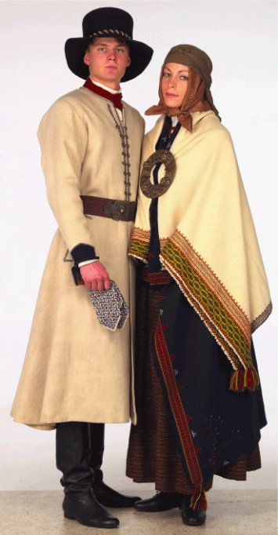
Celaine weaving technique is one of the oldest textile techniques in the territory of Latvia.
According to scientific research, celaine fabrics have been known since the Stone Age. In particular, a lot of celaine fabric samples have been found in the late Iron Age tombs and archaeological excavations help to reconstruct these ancient costumes worn by the Latvians.

Slide 4
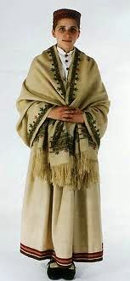
In ancient times celaine belt was used to supplement the clothing - as belts, hair ribbons or ribbon trim for skirts, puttee, reins, etc.
The edge finishing ribbon of a skirt, woven in celaine weaving technique.

Slide 5
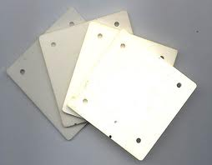
In ancient Egypt approximately 5x5 cm large cardboard, wooden (or in very ancient times, bronze) plates with rounded corners and holes for the thread in all four corners were used as celaine boards.
Weaving could take no more than 80 celaines (more would be difficult to hold in hands).
Woven pattern depends on both the number of times and direction of the thread and its rotation.

Slide 6
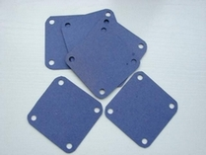
The Tools Necessary
2-3 mm thick squares of 5-8 cm long edges with a hole in each corner. Corners are slightly rounded. It is convenient to work with celaine tables which are thicker in the middle but thinner on edges.
Celaine tables
Materials used: wood, plastic or solid cardboard.

Slide 7
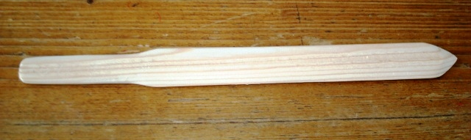
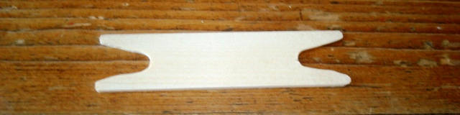
Paper knife – for parting the threads and fastening the weft.
Bobbin - for weaving the weft.
Two strong cords: one for tying up the ends at a fixed object, while the other - for tying warp ends at the waist.

Slide 8
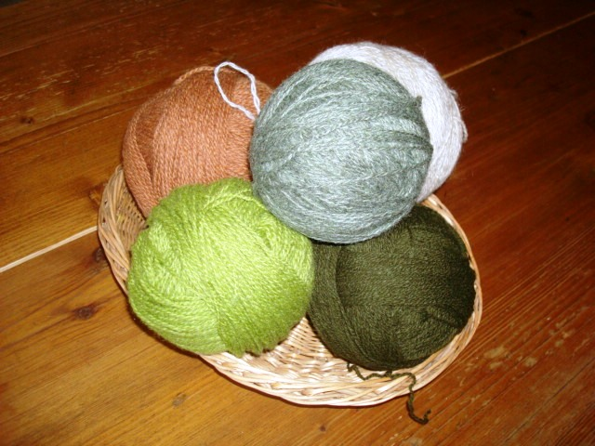
Materials
Thrown woolen yarn, cotton yarn or thread for crocheting can be used for celaine weaving. Thread No. 10 or 12 is necessary for weaving fine celaine.
Warp Length Calculation
As the length of warp yarns decreases while weaving, one fifth of the total length of the celaine should be added.
Warp length is calculated as follows:
Celaine length + (0.2 x celaine length) + 0.4 m for the ends.
For example, to weave 1.2 m long celaine belt, the required thread length for warp is calculated as follows:
1.2 + (0.2 x 1.2) + 0.4 = 1.84 m

Slide 9
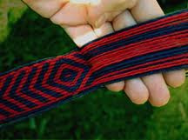
Celaine weaving technique allows several patterns such as straight, aslant or diagonal stripes and inwrought design.
Striped and herringbone celaines have been woven by the Latgalians since the 10th-11th century.
The oldest inwrought celaine dates back to the 9th century. More luxurious ones were woven by the Livs, Selonians and Latgalians starting with the 11th century when they were mostly found in belts. Celaines were mainly widespread in Latgale.
Ancient celaine woolen threads were in four colours - blue, yellow, red and brown, whereas the background was woven in light linen threads.

Slide 10
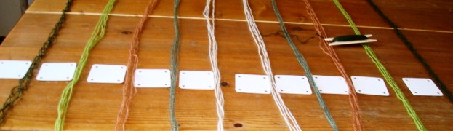
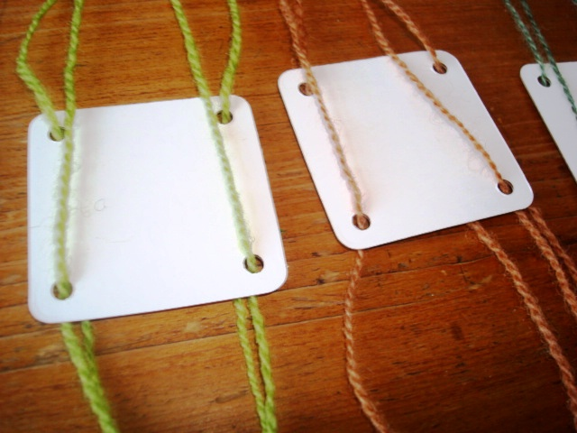
Celaine Weaving
- Put together four threads that will be used for the same celaine board.
- Warp is threaded from one side of the board.
- All thread ends must be together.

Slide 11
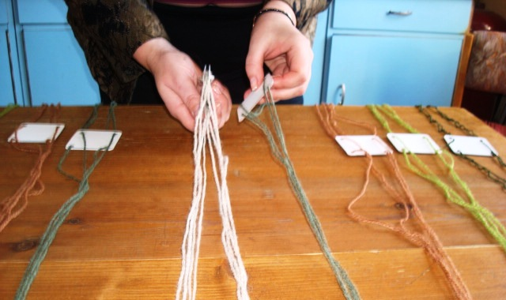
-Put celaine boards one above the other so that all threads are strung from one side.

Slide 12

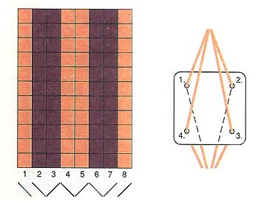
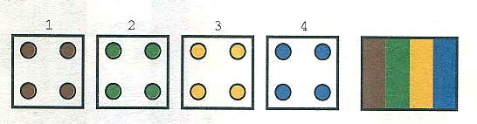
Striped Celaine
- Straight stripe is formed when the same colour yarn is in all four holes of the board.
- If the celaine boards are placed one above the other so that the thread goes from bottom to top, then twine is formed only on one side and the celaine rotates in a spiral.
- To avoid this it is necessary to place the celaine boards with threads opposite one another.
Weaving belts with straight stripes, all the celaine boards are turned - 90⁰ to the front.

Slide 13

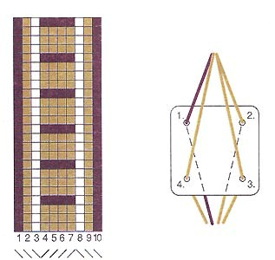
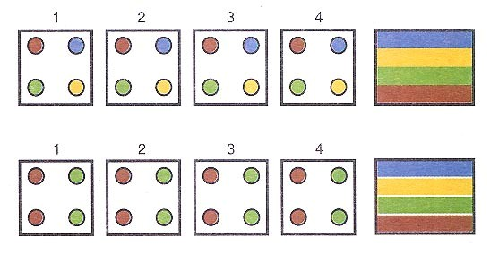
Transverse Stripe celaine
Weaving celaines transverse stripes of different width are formed from coloured yarn and the exact location of the boards so that the hole numbers would be placed one above the other.
To ensure that celaine is neat, the transverse stripes in the middle of the belt are enframed by straight stripes matching the colour.
Weaving is the same as for celaine with straight stripes: weft is woven into after the boards are turned to 90⁰.
Weft yarns are in the same colour as stripes on the edges.

Slide 14
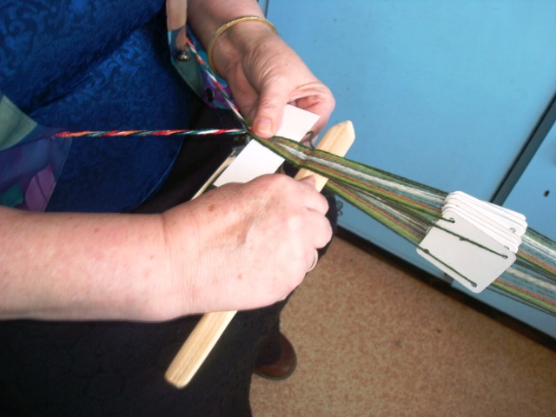
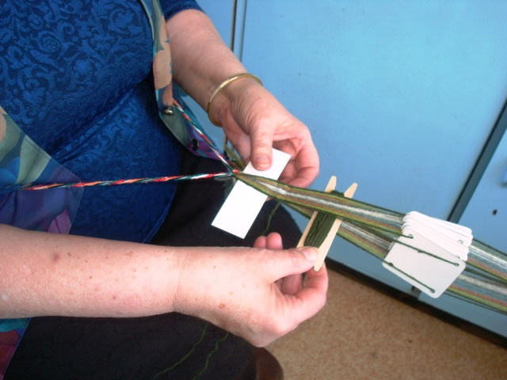
- Paper knife is used for smoothing the celaine.
- The edges should be neat and the whole celaine of equal width.
- Continue to weave while celaine is ready.
- Changing the parting turn celaine all the time to one side and after each quarter turn, weft thread should be woven in.
- Weaving celaine on the other side, the warp thread twists together that is why from time to time celaine should be untied and the threads unraveled.

Slide 15
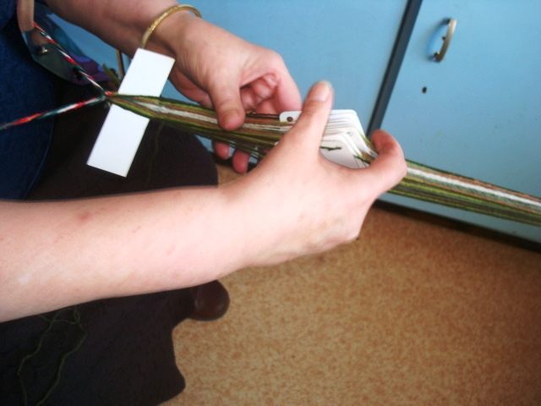
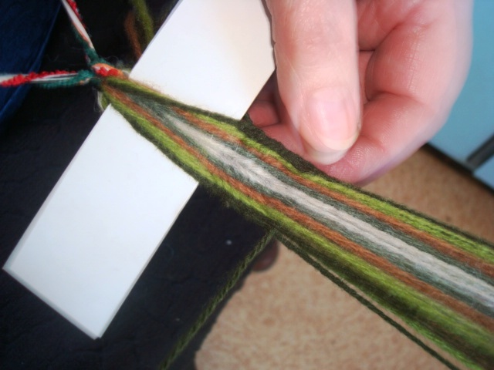
Thank you!
Good luck!

